Slide 1
Hit the Ground Running!
RDA Training for Music Catalogers
February 27, 2013

Slide 2
245 10 Creating RDA bibliographic records in MARC : $b a walkthrough. $n Part 1, $p Score / $c
Kevin Kishimoto,
University of Chicago.

Slide 3
Notes:
For this presentation I will demonstrate how to catalog a set of score and parts using RDA elements within MARC.

Slide 4
MARC record
040 __ CGU $b eng $e rda $c CGU
024 2_ 9790230811224
028 32 JJ11224 $b Editions Jobert
100 1_ Boesmans, Philippe, $e composer.
240 10 Fly and driving
245 10 Fly-driving : $b quatuor à cordes /$c Philippe Boesmans.
246 16 Quatuor à cordes
246 3_ Fly driving
264 _1 Paris : $b Editions Jobert, $c [2003?]
264 _3 $c 2003.
264 _4 $c ©1990
Notes:
A quick sneak peek of the finished record.

Slide 5
MARC record
300 __ 1 score (15 pages) ; $c 37 cm + $a 4 parts ; $c 33 cm
336 __ notated music $2 rdacontent
337 __ unmediated $2 rdamedia
338 __ volume $2 rdacarrier
500 __ Score is reproduction of composer’s holograph; parts are typeset.
500 __ “Realised by Hans Swinnen-1990”—Page 1 of parts.
500 __ “Ré impression. Lyon. 2003”—Page 15 of score.
500 __ Score ©1989; parts ©1990.
546 __ $b Staff notation.
505 0_ Fly -- Driving.
650 _0 String quartets $v Scores and parts.
700 1_ Swinnen, Hans, $e editor.

Slide 6
Same old OCLC work form, but slightly different coding
Fixed fields
Ldr/18 - Desc = i
MARC 040
$b eng
$e rda
$e follows directly after $b
040 __ CGU $b eng $e rda $c CGU
Notes:
Start with an OCLC score workform.
Set the fixed field “Desc” = i (which indicates ISBD punctuation)
In the 040 $b eng is required to code language of cataloging; $e rda is required to code descriptive conventions; PCC recommends that $e follow directly behind $b.

Slide 7
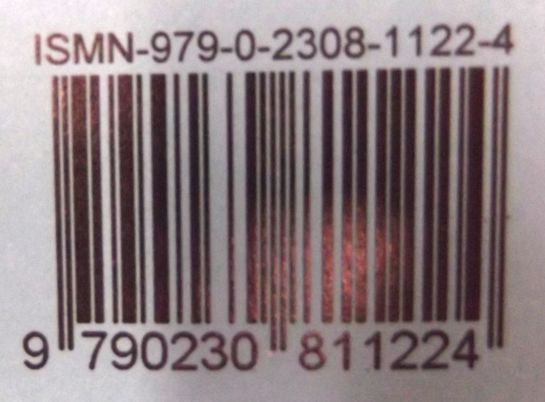
MARC 02X
MARC 024 / 028
RDA 2.15 - Identifier for the Manifestation
in RDA
ISMN 979-0-2308-1122-4
in MARC
024 2_ 9790230811224
Notes:
For the purposes of this demonstration, I will create the access points after recording the descriptive attributes of the resource.
For 024 ISMN – RDA instructs us to follow the prescribed display format. MARC coding, however, is without internal hyphens or spaces. Since we are coding in MARC, we follow MARC.

Slide 8
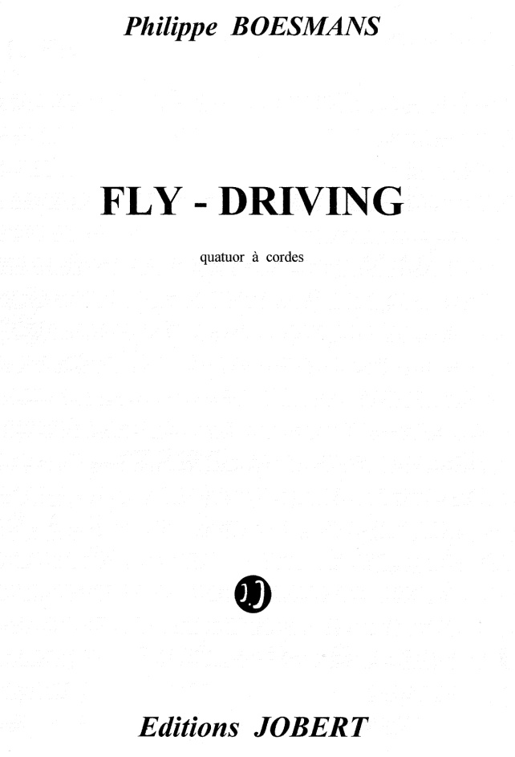
MARC 2XX
MARC 245
RDA 2.3 - Title & RDA 2.4 - Statement of responsibility
Notes:
Preferred source of information for scores is the title page.
Remember that the 245 is a transcribed field.

Slide 9
MARC 2XX
MARC 245
245 10 Fly-driving : $b quatuor à cordes /$c Philippe Boesmans.
or
245 10 FLY-DRIVING : $b quatuor à cordes /$c Philippe BOESMANS.
Notes:
Two versions of our 245 transcription with different capitalization allowed by RDA.

Slide 10
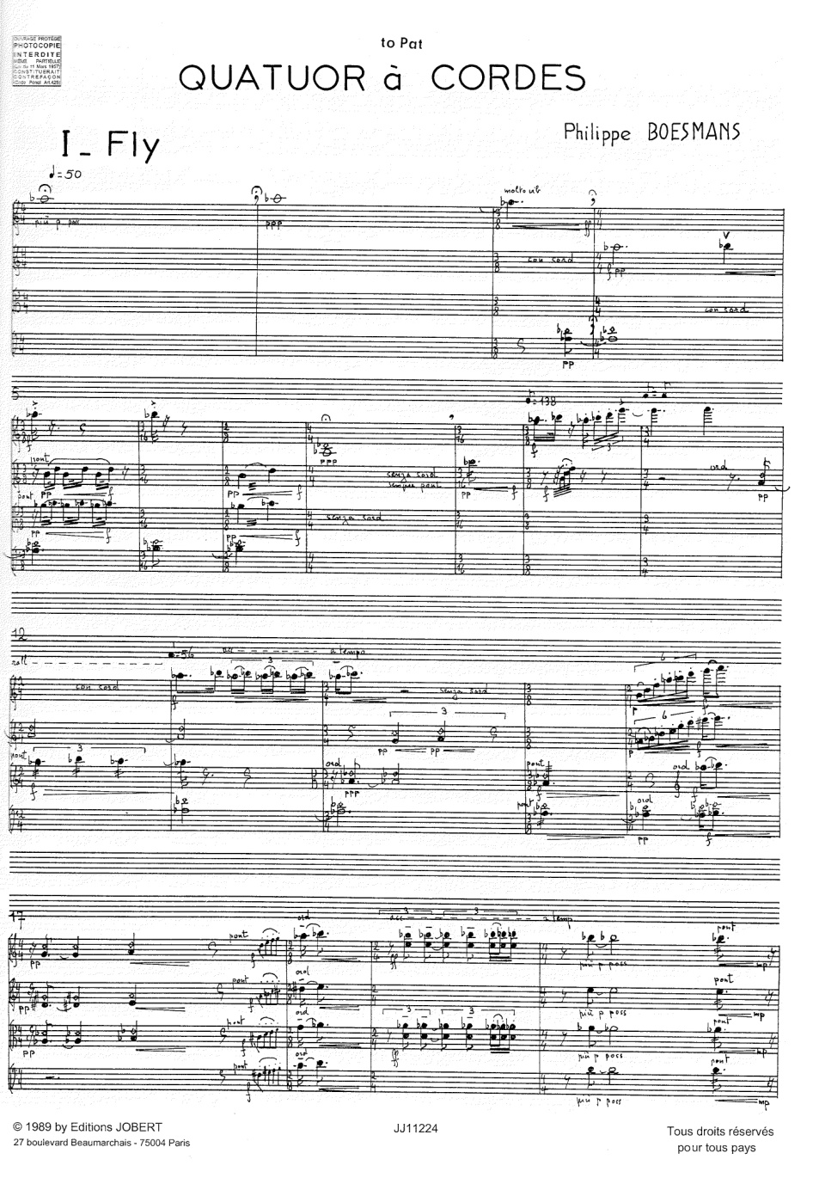
MARC 2XX
MARC 246
RDA 2.3.6 - Variant title
246 16 Quatuor à cordes
246 3_ Fly driving
Notes:
Variant title can be from any source.
The first 246 is for the caption title which differs from our title proper.
The second 246 is something I added to help our local catalog, which interprets the hyphen in the title proper as a no-space: “Flydriving.” This may not be required in your local ILS.

Slide 11
MARC 2XX
MARC 264
RDA 2.8-2.10 - Publication / Distribution / Manufacture statement
264 _1 Paris : $b Editions Jobert, $c ????
Notes:
In the 264, there are several things through which we need to sort before recording the publication date.

Slide 12
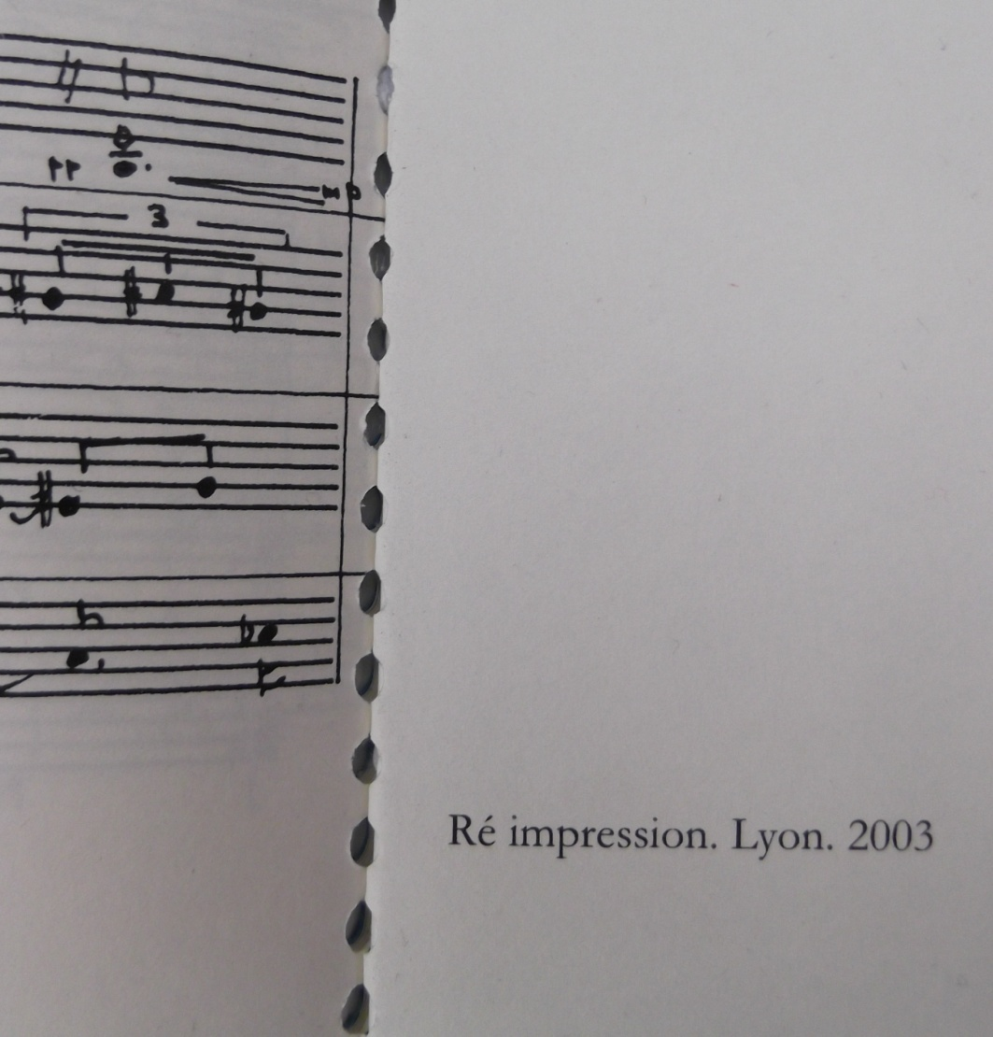
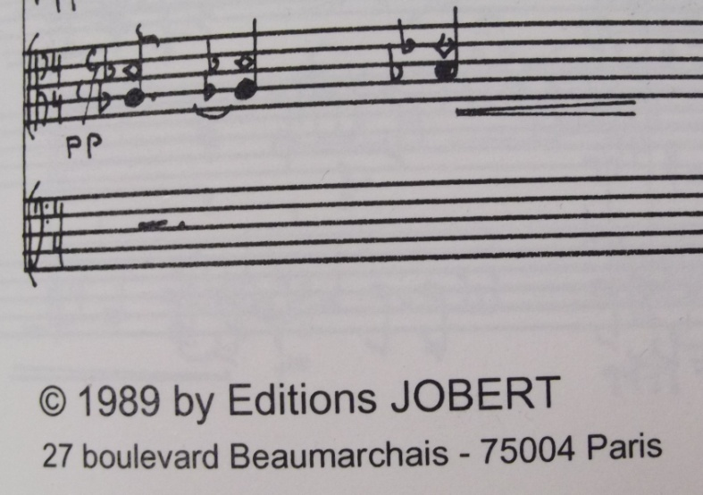
MARC 2XX
MARC 264
264 _1 Paris : $b Editions Jobert, $c [2003?]
264 _3 $c 2003.
Notes:
In RDA the copyright date cannot be used as a stand-in for the publication date. LC-PCC PS instructs us to “supply a date of publication if possible.” In other words, “[date of publication not identified]” should be reserved for those cases when you really have no idea.
Using the dates seen here, we will supply a probable date of publication from the date of reprinting, coded with square brackets and a question mark.
The 264 _3 allows us to record the date of manufacture, as seen here. This is not required since we have supplied a publication date.

Slide 13
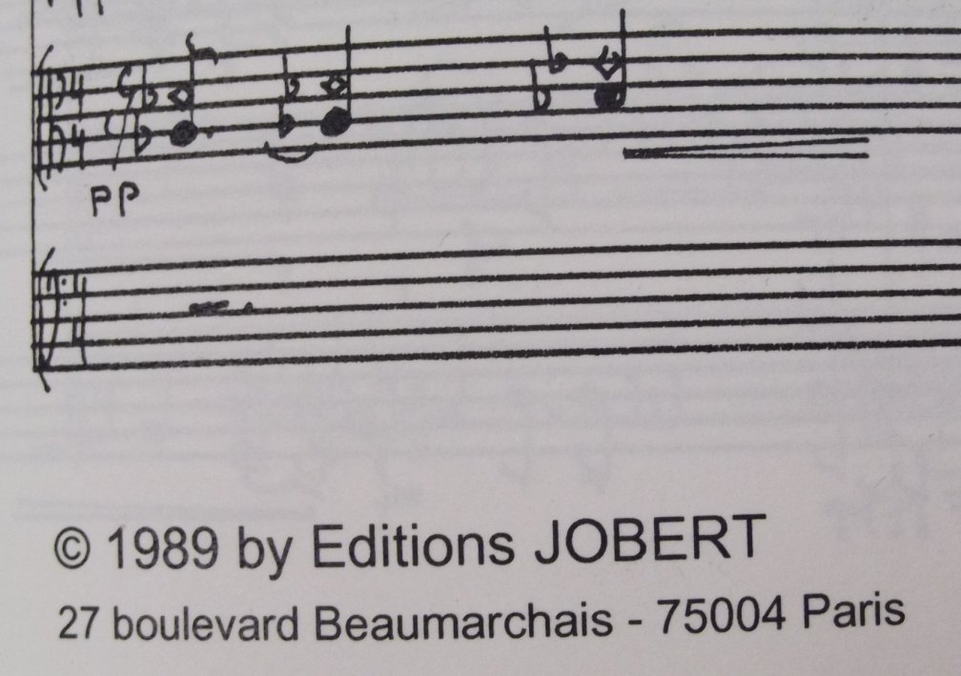
MARC 2XX
MARC 264
RDA 2.11 - Copyright date
264 _4 $c ©1990
or
264 _4 $c copyright 1990
Notes:
And the copyright date. This score + parts has two copyright dates, one for the score (and the likely work itself) and the other (presumably) for the typeset edition of parts.
If the resource has multiple copyright dates applying to different aspects, record the latest date.
The 264 copyright date does not have ending punctuation.

Slide 14
MARC 5XX notes
LC-PCC PS 2.20.7 - Note on publication statement
500 __ “Ré impression. Lyon. 2003”—Page 15 of score.
RDA 2.20.10 - Note on copyright date
500 __ Score ©1989; parts ©1990.
Notes:
Since effort was spent to straighten out the publication and copyright dates, 500 notes will aid users (and other catalogers).

Slide 15
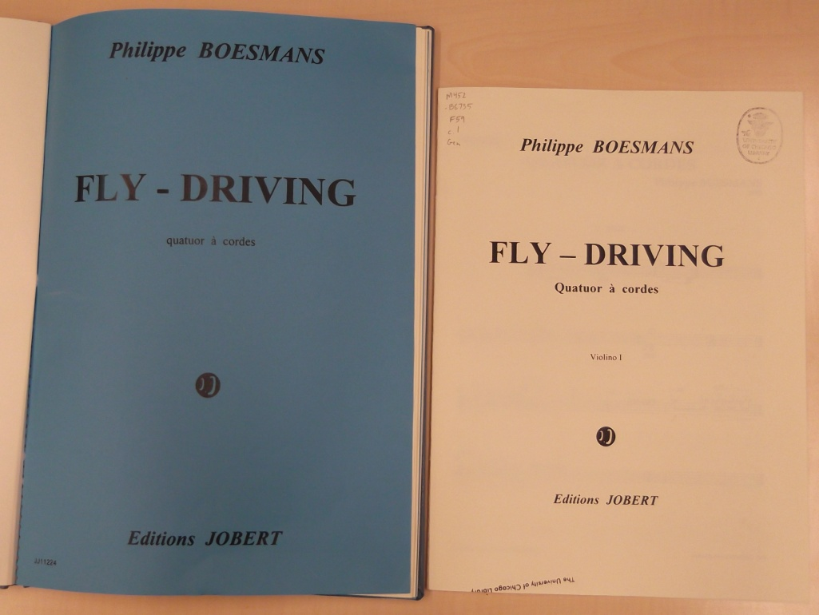
MARC 3XX
MARC 300
RDA 3.4 – Extent
RDA 3.5 - Dimensions
300 __ 1 score (15 pages) ; $c 37 cm + $a 4 parts ; $c 33 cm
37 cm
33 cm
Notes:
This resource is score + 4 parts, but they are different sizes.
MARC coding and RDA allow flexibility in recording physical description in the 300 fields. For scores & parts, $a and $c are repeatable within a single 300.

Slide 16
MARC 3XX
MARC 336, 337, 338 – New MARC fields for RDA
RDA 6.9, 3.2, 3.3
336 __ notated music $2 rdacontent
337 __ unmediated $2 rdamedia
338 __ volume $2 rdacarrier
Notes:
33X fields...

Slide 17
MARC 5XX notes
RDA 2.20.3 - Note on statement of responsibility
500 __ “Realised by Hans Swinnen-1990”—Page 1 of parts.
RDA 7.20.1.4 - Details of format of notated music
500 __ Score is reproduction of composer’s holograph; parts are typeset.
RDA 7.13.3 – Form of musical notation
546 __ $b Staff notation.
RDA 25.1 - Related work [Parts of a work]
505 0_ Fly -- Driving.
Notes:
More 5XX notes...
Currently, RDA does not include instructions on creating contents notes for resources which contain a single work, in other words, a structured description of the parts (chapters or movements) within the work. “Fly” and “Driving” are the names of the individual movements. I’ve (maybe illegally) created this 505 contents note based on past AACR2 practice, and await further guidance from RDA, LC-PCC PS, MLA BCC, and others.

Slide 18
Authorized access points
RDA 19.2 - Creator + 18.5 - Relationship designator
100 1_ Boesmans, Philippe, $e composer.
RDA 19.2 - Other person, family, or corporate body associated with a work + 18.5 - Relationship designator
700 1_ Swinnen, Hans, $e editor.
Notes:
Authorized access points for creator and contributor, both with relationship designators.

Slide 19
Authorized access points
RDA 17.8 - Work manifested + RDA 6.28
[NACO authority record]
100 1_ Boesmans, Philippe. $t Fly and driving
[bibliographic record]
100 1_ Boesmans, Philippe.
240 10 Fly and driving
or
700 12 Boesmans, Philippe. $t Fly and driving.
Notes:
Notice the preferred title of this work found in the NACO authority file is slightly different from that which we see on the resource.
In our bibliographic record, we can code this authorized access point two different ways: in the 100/240 combination, or the 700.

Slide 20
Authorized access points
RDA 17.8 - Work manifested
100 1_ Boesmans, Philippe, $e composer.
240 10 Fly and driving
Beware! Watch out for the intervening $e!
Boesmans, Philippe, $e composer. $t Fly and driving.
Notes:
I am coding the authorized access point for the work in the MARC 100/240 combination as we have been accustom. But notice that the $e in the 100 would intervene between the name and title. My local system is able to deal with this, creating an access point combining the 100 and 240 while not including the $e in the name and name/title indexes, but your mileage may vary. Testing is important.

Slide 21
Subject headings
Subject access continues through the use of LCSH
650 _0 String quartets $v Scores and parts.
How about???
650 _0 Transportation $v Songs and music.
Notes:
Subject access continues as in AACR2. The RDA chapters for FRBR group 3 entities and subject access have not yet been written.

Slide 22
MARC record
040 __ CGU $b eng $e rda $c CGU
024 3_ 9790230811224
028 32 JJ11224 $b Editions Jobert
100 1_ Boesmans, Philippe, $e composer.
240 10 Fly and driving
245 10 Fly-driving : $b quatuor à cordes /$c Philippe Boesmans.
246 16 Quatuor à cordes
246 3_ Fly driving
264 _1 Paris : $b Editions Jobert, $c [2003?]
264 _3 $c 2003.
264 _4 $c ©1990
Notes:
Our complete RDA MARC bibliographic record for a score + parts.

Slide 23
MARC record
300 __ 1 score (15 pages) ; $c 37 cm + $a 4 parts ; $c 33 cm
336 __ notated music $2 rdacontent
337 __ unmediated $2 rdamedia
338 __ volume $2 rdacarrier
500 __ Score is reproduction of composer’s holograph; parts are typeset.
500 __ “Realised by Hans Swinnen-1990”—Page 1 of parts.
500 __ “Ré impression. Lyon. 2003”—Page 15 of score.
500 __ Score ©1989; parts ©1990.
546 __ $b Staff notation.
505 0_ Fly -- Driving.
650 _0 String quartets $v Scores and parts.
700 1_ Swinnen, Hans, $e editor.

